Slide 1

Lecture 2: Introduction to Java Applications Object Oriented Concepts and Programming

Slide 2
OO Programming Concepts
Object-oriented programming (OOP) involves programming using objects. An object represents an entity in the real world that can be distinctly identified. For example, a student, a desk, a circle, a button, and even a loan can all be viewed as objects. An object has a unique identity, state, and behaviors. The state of an object consists of a set of data fields (also known as properties) with their current values. The behavior of an object is defined by a set of methods.

Slide 3
Objects
An object has both a state and behavior. The state defines the object, and the behavior defines what the object does.

Slide 4
Object
Objects are key to understanding object-oriented technology.
Examples of real-world objects: your dog, your desk, your television set, your bicycle.
Real-world objects share two characteristics: They all have state and behavior.
Dogs have state (name, color, breed, hungry) and behavior (barking, fetching, wagging tail).
Bicycles also have state (current gear, current pedal cadence, current speed) and behavior (changing gear, changing pedal cadence, applying brakes).
Identifying the state and behavior for real-world objects is a great way to begin thinking in terms of object-oriented programming.

Slide 5
Objects (Contd)
Take a minute right now to observe the real-world objects that are in your immediate area.
For each object that you see, ask yourself two questions:
"What possible states can this object be in?"
"What possible behavior can this object perform?“
Real-world objects vary in complexity;
your desktop lamp may have only two possible states (on and off) and two possible behaviors (turn on, turn off),
Desktop radio might have additional states (on, off, current volume, current station) and behavior (turn on, turn off, increase volume, decrease volume, seek, scan, and tune).

Slide 6
Classes:
People,books,dogs,cats,cars,airplanes,trains,etc.
Instance of a class
You, your parents, the book you are reading, the car you drive
Example: Car class
Property names Method Names
model startEngine
year stopEngine
Color accelerate

Slide 7
Class
A class is the blueprint from which individual objects are created.
In object-oriented terms, we say that your bicycle is an instance of the class of objects known as bicycles.

Slide 8




More on Classes and Objects
A Java program consists of one or more classes
A class is an abstract description of objects
Class is a template for an object
Class defines a new data type
Once defined, this new data type can be used to create objects of that type
An object is instance of a class.
Because an object is an instance of a class, you will often see the two words object and instance interchangeably
Here is an example class:
class Dog { ...description of a dog goes here... }
Here are some objects of that class:

Slide 9
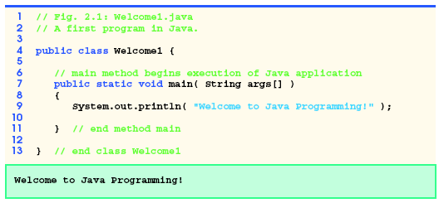
A Simple Java Program

Slide 10
Java Types
Java has two basic types
Primitive types
Reference Types
Primitive types
integers, floating point numbers, characters, etc
Refer to actual values
Reference types
Arrays, Classes, Objects, etc
Refer to memory locations (by name, not location)
Notes:
Primitive types are basic values. References types are structures (arrays, classes, objects, etc). A reference is as close as Java gets to a C pointer, but references are accessed by name and not by location.
A Java programmer has no control over memory allocations, locations, etc.
Ideally in an OO language everything would be an object of some form, and Java does have objects that represent the kinds of values that can be stored in primitive types. However reference types take up more memory so for efficiency, Java allows values to be stored in a primitive form.

Slide 11
Primitive Types
Type | Description | Size
Boolean (boolean) | True/false value | 1 bit
Byte (byte) | Byte-length integer | 1 byte
Short (short) | Short integer | 2 bytes
Integer (int) | Integer | 4 bytes
Long (long) | Long Integer | 8 bytes
Float (float) | Single precision floating point number | 4 bytes
Double (double) | Double precision float | 8 bytes
Char (char) | Single character | 2 bytes

Slide 12
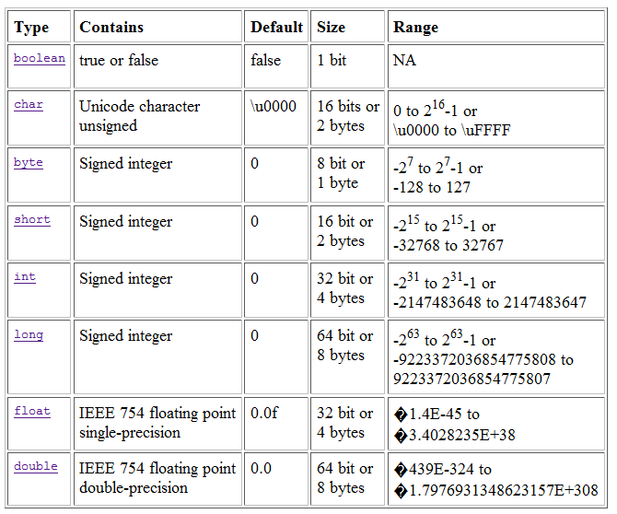
Java Basic Types

Slide 13
Naming
All Java syntax is case sensitive
Valid Java names
Consist of letters, numbers, underscore, and dollar
Names can only start with letter or underscore
E.g. firstAttribute but not 1stAttribute
“Camel case” convention
Java encourages long, explanatory names
Start with a lower case letter, with words capitalised
E.g. thisIsCamelCase, andSoIsThisAsWell
Notes:
Meaningful names are an important way to make your code understandable. While the later examples don’t always follow that recommendation, that’s just to save space on the slides.
Camel case is also recommended as it makes long identifier names much more readable. It’s called camel case because there are humps in the words!
Note that there are naming conventions for method names and variables also (see later slides)

Slide 14
Naming Guidelines
The rules for variable names and identifiers follow the same conventions as C:
Variables and methods must start with lowercase
double x;
int sessionalMarks=0;
public void accountDetails();
studentMarks is preferred to student-marks
Class names must start with uppercase
public class HelloWorld{}

Slide 15
Naming Guidelines (Contd)
Lower Camel Case: Each new word begins with a capital letter except the first letter of the name is in lowercase (e.g., hasChildren, customerFirstName, customerLastName).
Using proper naming convention increases the readability of your program.
Use pronounceable names
Be brief
calculateArea instead of calculateTheAreaOfRectangle

Slide 16
Syntax Examples (Variables)
int anInteger;
Boolean isSwitchOn;
Variables can be initialised when they are declared
Int anInteger = 10;
Boolean isSwitchOn = true;

Slide 17
Java for Beginners
Java class name is also called identifier
Reserved words or keywords are reserved by java and cannot be used as identifiers
Identifier may contain letters, dollar sign, underscores, digits and letters
Identifier does not begin with a digit
Identifier does not contain spaces
Valid Identifiers | Invalid Identifiers
_Hello | 1Name
Hello_World | Hello World
Name1

Slide 18
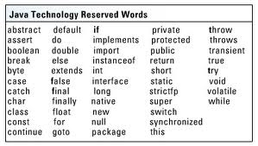
Java Reserved Words
Reserved words cannot be used as identifiers.

Slide 19
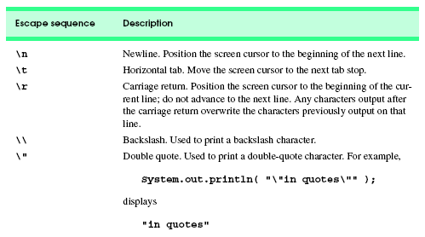
Escape Sequences in Java
Backslash (\) is called an escape character.
When a backslash appears in string of characters. Java combines the next character with the backslash to form an escape sequence.

Slide 20
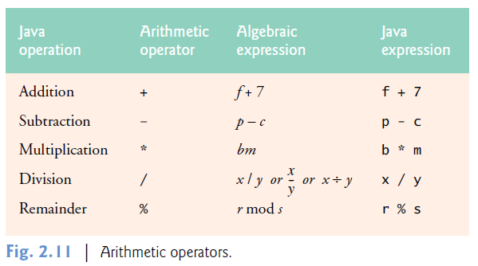
Arithmetic Operators

Slide 21
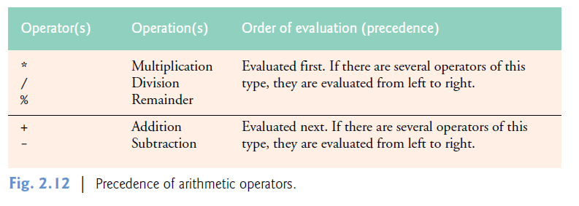
Precedence of Arithmetic Operators

Slide 22
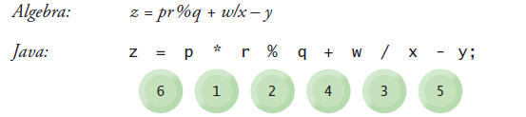


Precedence of Arithmetic Operators (Contd)

Slide 23
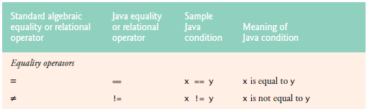
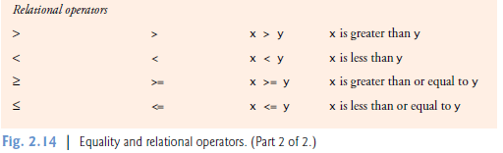
Equality and Relational Operators

Slide 24
Basic Addition Program
import java.util.Scanner ;
public class Addition
{
public static void main (String[] args)
{
Scanner input = new Scanner (System.in);
int num1, num2, sum;
System.out.println (“Enter first number:");
num1 = input.nextInt();
System.out.println (“Enter second number:");
num2 = input.nextInt();
sum = num1 + num2 ;
System.out.printf ("sum = %d\n", sum);
}
}

Slide 25
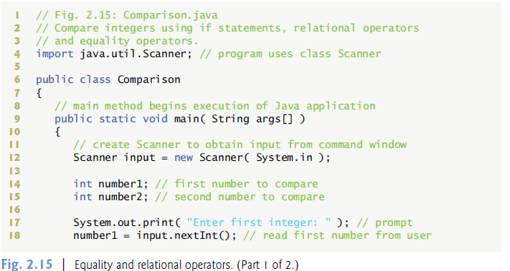
Simple Program with Equality and Relational Operators

Slide 26
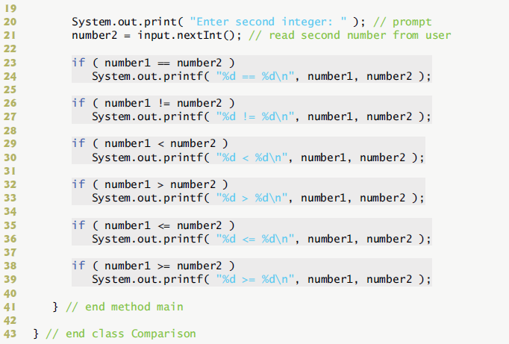
Simple Program with Equality and Relational Operators (Contd)

Slide 27
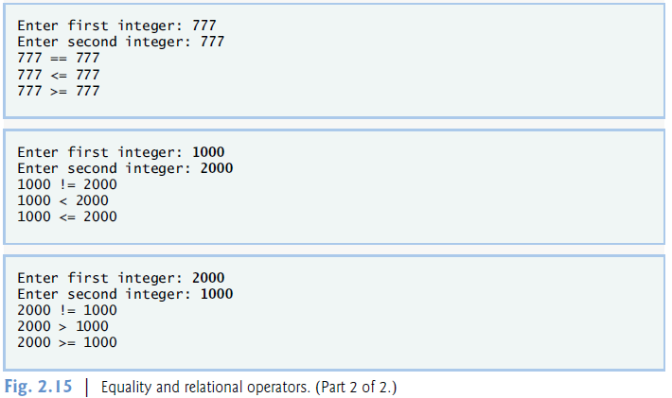
Output

Slide 28
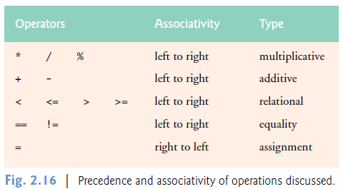
Precedence and Associatively of Operations

Slide 29
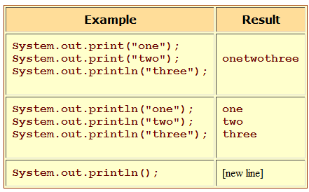
Print statements
There are three kinds of print statements:
System.out.print(argument) just prints out its argument, and
System.out.println(argument) prints out its argument and ends the line.
A third kind, System.out.printf(format, arguments), gives more control over how things are printed.

Slide 30
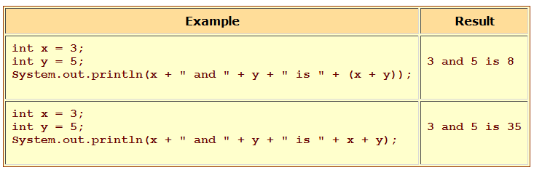
Print statements (contd)

Slide 31

Print statements (contd)
Numerical values are formatted according to format specifiers like those for the printf() function in C.
Format Specifiers: %b boolean, %c character, %d integer %f floating point
%s string, %n a new line
Example:
double pi = Math.PI;
System.out.printf ("pi = %5.3f", pi);
System.out.println();
System.out.printf ("pi = %10.4f", pi);
Output

Slide 32
Syntax Examples (if)
if (x == y)
{
//executes if true
}
if (somethingIsTrue())
{
doSomething();
}
else
{
doSomethingElse();
}

Slide 33
Example (for)
int x=0;
for (int i=1; i<=10; i++)
{
//code to repeat ten times
x = x + i;
}

Slide 34
Example (while)
int x=0;
while (x < 10)
{
doSomething();
x++;
}
//loop forever
while (true)
{
}

Slide 35
Thinking About Objects: Introduction to Object Technology and the Unified Modeling Language
Object orientation
Unified Modeling Language (UML)
Graphical language that uses common notation
Allows developers to represent object-oriented designs

Slide 36
Thinking About Objects (cont.)
Objects
Reusable software components that model real-world items
Look all around you
People, animals, plants, cars, etc.
Attributes
Size, shape, color, weight, etc.
Behaviors
Babies cry, crawl, sleep, etc.

Slide 37
Thinking About Objects (cont.)
Object-oriented design (OOD)
Models real-world objects
Models communication among objects
Encapsulates data (attributes) and functions (behaviors)
Information hiding
Communication through well-defined interfaces
Object-oriented language
Programming is called object-oriented programming (OOP)
Java

Slide 38
Thinking About Objects (cont.)
Object-Oriented Analysis and Design (OOAD)
Essential for large programs
Analyze program requirements, then develop solution
We begin OOAD in Chapter 2
Elevator-simulation case study

Slide 39
Thinking About Objects (cont.)
History of the UML
Need developed for process with which to approach OOAD
Brainchild of Booch, Rumbaugh and Jacobson
Object Management Group (OMG) supervised
Version 1.4 is current version
Version 2.0 scheduled tentatively for release in 2002

Slide 40
Thinking About Objects (cont.)
UML
Graphical representation scheme
Enables developers to model object-oriented systems
Flexible and extendible

Slide 41
Unified Modelling Language
UML is a diagramming tool for describing and documenting object oriented applications
Programming language independent
Used for modelling an application before its engineered
Twelve different diagrams in all, with many complex details
Generally though only two of these are used regularly
Class diagrams
Sequence diagrams
Notes:
The reason I’m introducing a few UML basics is because it makes talking about applications much easier, as we can produce a diagram describing the classes and their relationships, rather than just jumping into the code.
It’s also a useful skill in its own right, and is generally encountered in OO design documents.

Slide 42
Unified Modelling Language
Class Diagrams
Describe classes and interfaces
…their properties
…their public interface
…and their relationships (e.g. inheritance, aggregation)
Sequence Diagrams
Describe how objects send messages to one another
Useful for describing how a particular part of an application works
We’ll be covering just class diagrams
Very useful for describing APIs and discussing OO applications

Slide 43
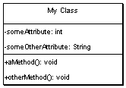
UML -- Classes
Box with 3 sections
The top contains the class name
The middle lists the classes attributes
The bottom lists the classes methods
Can indicate parameters and return types to methods, as well as their visibility

Slide 44
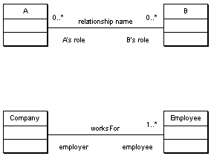
UML -- Association
A line between two classes indicates a relationship
Extra information can be added to describe the relationship
Including
Its name
The roles that the classes play
The cardinality of the relationship (how many objects are involved)
E.g. a Person worksFor a Company, which has many employees

Slide 45
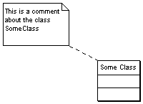
UML -- Comments
Useful for adding text for the readers of your diagram
The symbol looks like a little post-it note, with a dotted line joining it to the class or relationship that its describing

Slide 46

UML -- Aggregation
Aggregation (a whole-part relationship) is shown by a line with clear diamond.
As aggregation is a form of relationship you can also add the usual extra information
I.e.
Name
Roles
Cardinality

Slide 47
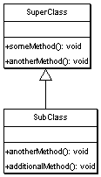
UML -- Inheritance
Inheritance is shown by a solid arrow from the sub-class to the super-class
The sub-class doesn’t list its super-class attributes or methods,
unless its providing its own alternate version (I.e. is extending the behaviour of the base class)

Slide 48
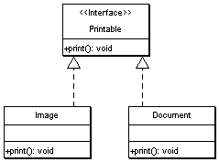
UML -- Interfaces
Interfaces are a way to specify behaviour (a public contract) without data or implementation.
Interfaces are classed with an extra label next to their name: <<Interface>>
A dotted arrow from a class to an interface explains that the class fulfills the contract specified by that interface

Slide 49
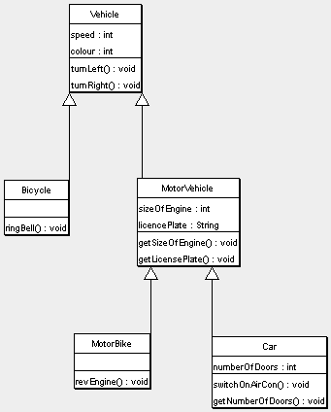
Example #1

Slide 50
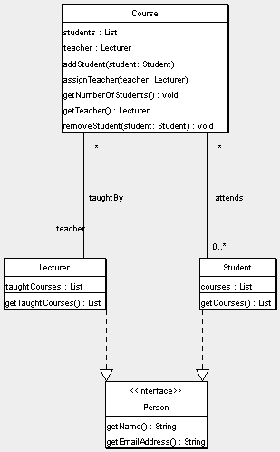
Example #2

Slide 51
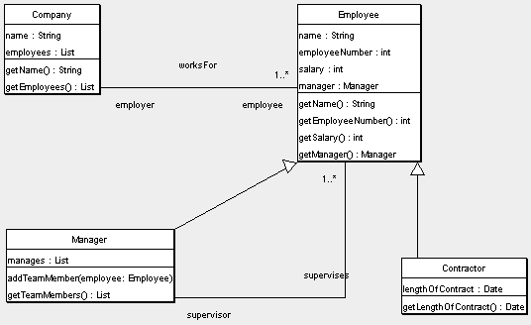
Example #3

